Slide 1
A Novel TF-IDF Weighting Scheme for Effective Ranking
Pratik Patil (CS2313)

Slide 2
Why Novel TF-IDF Weighting Scheme for Effective Ranking?
Drawbacks of existing models :-
Most of the existing models employ a single term frequency normalization mechanism that does not take into account various aspects of a term’s saliency in a document.
For example, frequency of a term in a document relative to the frequency of the other terms in the same document gives us an important clue that can not be achieved by the commonly used document length based normalization scheme.
On the contrary, length based normalization can restrict the likelihood of retrieval of extremely long documents which can not be taken care of by the relative frequency based term weighting.

Slide 3
Why Novel TF-IDF Weighting Scheme for Effective Ranking?
Drawbacks of existing models :-
Another major limitation of the present models is that they do not balance well in preferring short and long documents.
Such limitation makes a system to retrieve low quality documents at the top of the ranked list when they face queries of varying length.

Slide 4
Proposed Work to overcome drawbacks
Novel TF-IDF Weighting Scheme for Effective Ranking proposes term weighting scheme that can address these weaknesses in an effective ways.
In this article they make the following contribution.

Slide 5
a) Term frequency normalization scheme
Term frequency Normalization
Component of the term frequency tends to prefer long documents
Component of the term frequency tends to prefer short documents

Slide 6
b) Query length information
It uses the query length information to emphasize the appropriate component.
In particular, when the system faces a long query, it down-weights the part that prefers long documents in order to compensate the effect and vice versa.

Slide 7
c) Term discrimination measure
It modifies the usual term discrimination measure (idf) by integrating mean term frequency of a term in the set of documents the term is contained in.

Slide 8
d) Asymptotically bounded function
Finally, we use asymptotically bounded function to transform the tf factors that better handles the term coverage issues in the documents and also helps to combine the two tf factors more easily.
As a bi-product of such transformation, the ranking function easily produces the similarity values in the range of [0-1].

Slide 9
STATE OF THE ART
Most IR systems assign a numeric score to the documents and then they are ranked based on these scores.
Three widely used models in IR are
IR models
Vector space model
Probabilistic model
Inference network model

Slide 10
PROPOSED WORK
Preliminaries
The main motivation behind our work based on three key hypotheses
A) Term Frequency Hypothesis (TFH)
B) Document Length Hypothesis (DLH)
C) Term Discrimination Hypothesis (TDH)

Slide 11

PROPOSED WORK
Preliminaries
Two Aspects of TF
A) Relative Intra-document TF (RITF): The importance of a term is measured by considering its frequency relative to the average TF of the document. Where TF(t, D) and Avg.TF(D) denote the frequency of the term t in D and average term frequency of D respectively.

Slide 12
PROPOSED WORK
Preliminaries
Two Aspects of TF
B) Length Regularized TF (LRTF):
This factor normalizes the term frequency by considering the number of terms present in a document.
We assume that the appropriate length of a document should be the average document length of the collection and the frequency of the terms of an average length document should remain unchanged.
It seems unlikely that the increase in term frequency follows a linear relationship with the document length, and thus the above formula over-penalizes the long documents.

Slide 13

PROPOSED WORK
Preliminaries
Two Aspects of TF
B) Length Regularized TF (LRTF):
To overcome this bias, we employ the following function to achieve the length dependent normalization.
ADL(C) is the average document length
len(D) is the length of the document D.

Slide 14
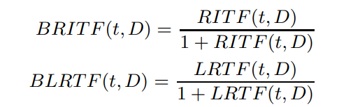
PROPOSED WORK
Transforming TF Factors
We transform the T F factors using a function f(x) that possesses the following properties: (i) vanishes at 0, (ii) satisfies the two conditions of AD-TFH hypothesis (f’(x) > 0 and f’’(x) < 0), and (iii) asymptotically upper bounded to 1.
One of the simplest functions that satisfies the above properties is f(x) = x/(x+1).
Using this function, we now transform the two TF factors as follows:

Slide 15
PROPOSED WORK
Combining Two TF Factors
How should we combine BRITF(t, D) and BLRTF(t, D)? A natural way to do this is as follows:
Where 0 <w< 1. The next important issues that arise out of Equation 7 are the following:
• Should we prefer BRITF(t, D) (w > 0.5)?
• Should we prefer BLRTF(t, D) (w < 0.5)?

Slide 16
PROPOSED WORK
Combining Two TF Factors
BRITF(t, D) has a tendency to prefer long documents, since for long documents the denominator part of RITF(t, D) is close to 1, and TF is usually larger.
On the other hand, BLRTF(t, D) tends to prefer short documents, since LRTF(t, D) → 0 as len(D) → ∞. Therefore, when a query is long, BRITF(t, D) heavily prefers extremely long documents, since the number of matches is more or less proportional to the length of the document.
On the contrary, since BLRTF(t, D) prefers short documents it can penalize extremely long documents when it faces longer queries, and thus it is preferable when longer queries are encountered.
Another interesting property of BRITF(t, D) is that it emphasizes on the number of matches, since the main component of this formula RITF(t, D) heavily punishes the term frequency, and thus important for the short queries.

Slide 17
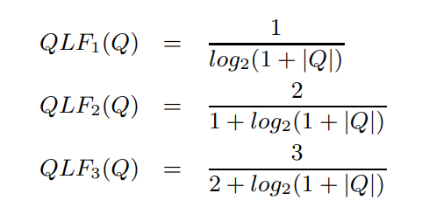
PROPOSED WORK
Combining Two TF Factors
The query length information into our weighting formula. The value of w should decrease with the increase in query length, while it must lie between [0-1].
Specifically, we characterize the query length factor (QLF(Q)) by the following variables.
(i) QLF(Q) = 1 for |Q| = 1
(ii) QLF’(Q) < 0
(iii) 0 < QLF(Q) < 1
We used the following three different functions.

Slide 18


PROPOSED WORK
Term Discrimination Factor
The goal of the term discrimination factor in weighting is to assign higher score to the documents that contain the terms which are rare in the collection.
Inverse document frequency (IDF) is a well known measure that serves the above purpose.
We use the following standard idf measure.
In particular, we hypothesize that if two terms have equal document frequencies, then the term discrimination should increase with the increase in average elite set term frequency.
The average elite set term frequency (AEF) is defined as:

Slide 19

PROPOSED WORK
Term Discrimination Factor
However, the combination of raw AEF with IDF may disturb the overall term discrimination value, since the IDF values are obtained by dampening through log function.
Hence, we employ a slowly increasing function to transform the AEF values for this combination. Once again, we use the function f(x) = x/(1 + x) to transform the AEF values for the final use.
The final term discrimination value of term t is computed as

Slide 20
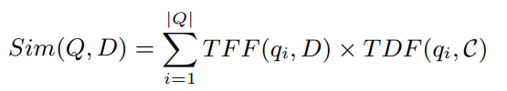

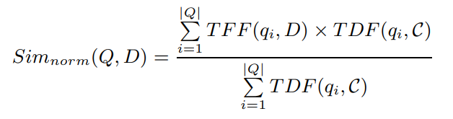
PROPOSED WORK
Final Formulation
Integrating the above factors we now obtain the following final scoring formula
Again, since TFF(qi, D) < 1, we obtain the following relationship.
Therefore, we can easily modify Equation 13 to get the normalized similarity scores (0 < Sim(Q, D) < 1) as follows:

Slide 21

EXPERIMENTAL SETUP
Data
The experiments are conducted on a large number of standard test collections, that vary both by type, the size of the document collections and the number of queries.
TREC-6,7,8 collection uses binary relevance assessment.

Slide 22
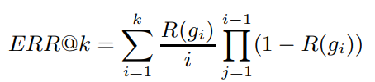
EXPERIMENTAL SETUP
Evaluation Measures and IR System
We use the following metrics to evaluate the systems.
Mean Average Precision (MAP): This is a standard metric for binary relevance assessment.
Normalized DCG at k (NDCG@k): Discounted cumulative gain (DCG) is an evaluation measure that can leverage the relevance judgment in terms of multiple grades, and has an explicit position-wise discount factor. NDCG is the normalized version of DCG.
Expected Reciprocal Rank at k (ERR@k): It discounts the documents which are shown below very relevant documents, and is defined as the expected reciprocal length of time that a user will take to find a relevant document.
where R(g) = (2^{g}−1)/2^{hg} , hg is the highest grade and g1, g2... gk are the relevance grades associated with the top k documents

Slide 23
THANK YOU

